Slide 1
Customer Segmentation A customer-centric strategy
Brazilian E-Commerce Public Dataset by Olist

Slide 2
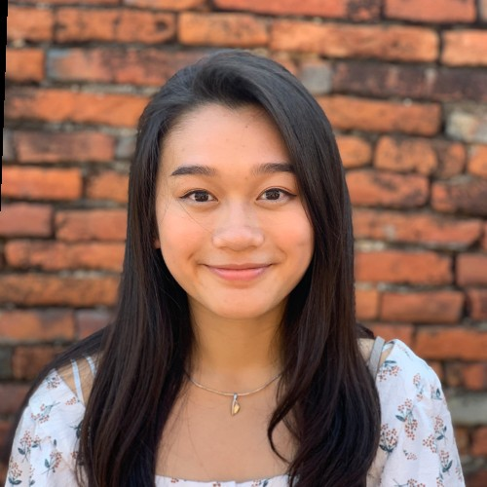
Introduction
Naramol Pipoppinyo
From Thailand, born and raised in Indonesia and Nepal.
In the Netherlands for four years.
Bsc – Communication Science @ University of Amsterdam
MscBa – Business Analytics & Management @ Erasmus University Rotterdam
Special in data-driven strategies especially in marketing and customer analytics

Slide 3
Table of Contents
01
Introduction
02
Data Analysis
Applying the Segments
04
Conclusion
03
to Olist, Objectives, & the dataset
K-means clustering, results, and customer segments
Geographical, Product Category, & Customer Review
Applying the segments, business recommendations, & next steps.

Slide 4
Introduction
To the organization Olist, the Objectives, & the dataset.

Slide 5
Introduction to Olist
Process
Customer purchases the product
The store seller gets notified to fulfill the order
The product gets shipped using Olist logistics partners
The customer receives the product and gets a satisfaction survey by email
Largest department store in the Brazilian marketplace
Connecting small businesses to channels with a single contract

Slide 6
Objective
Define a customer segmentation strategy to…
Identify actionable opportunities.
Take data-driven decisions.
Understanding the consumer base and purchasing behaviors.
2. Demonstrate…
Capabilities of the e-commerce database.
The capability of data analytics for customer-centric e-commerce strategies.

Slide 7
Exploring the Dataset
Categories | Description | Variables
Orders | Data about the items purchased | Transaction Value Order & Delivery Timestamp Quantity
Product | Details about the products sold on Olist | Product description Category
Reviews | Satisfaction survey filled out via email by those who receive a product | Scores (1 - 5) Comment messages
Geography | Brazilian zip codes and its lat/lng coordinates | Location of customer Location of seller

Slide 8
Data Analysis
Understanding the data engineering, k-means clustering (with RFM), the results, & chosen segments .

Slide 9
Behavioural Segmentation
Why Behavioural?
Data Engineering:
Available data.
Customer journey: understanding how customers engage with the platform.
Focusing on the actions, behavior, and preferences of a consumer.
Cascades into geographic, demographic, and product segmentation.
Recency: how recently a customer ordered
Frequency: how many times they bought the product
Monetary: How much individuals spent on an order
Price: price of the product they ordered
Payment Installments: the number of times a customer divided up their payments
*Data cleaning and preprocessing took place before in order to engineer the variables.

Slide 10
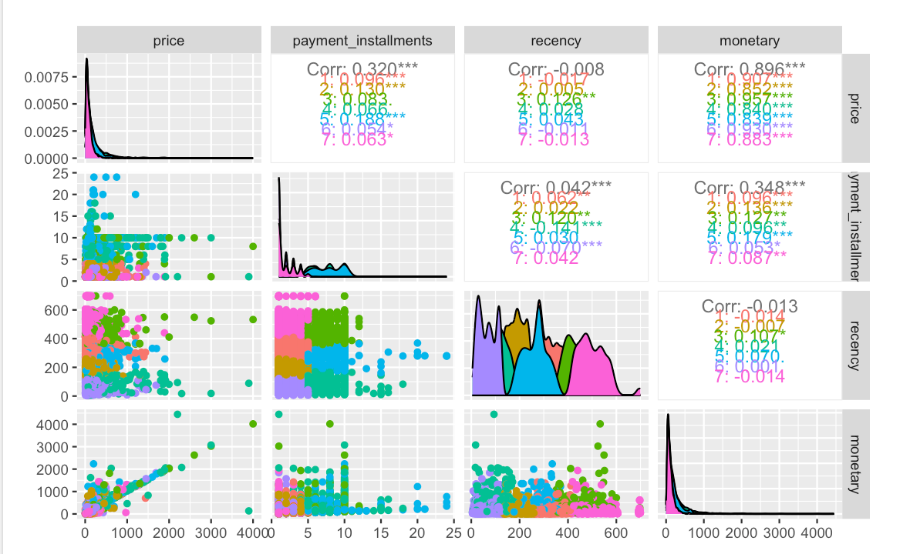
Chosen Segmentation Method: What is K-means Clustering?
Machine learning algorithmm that makes inferences.
Objective: group “similar” data points together to discover underlying patterns based on the dataset.
K = the number of clusters (segments) that we tell the algorithm to create for us based on the information fed into the model.

Slide 11
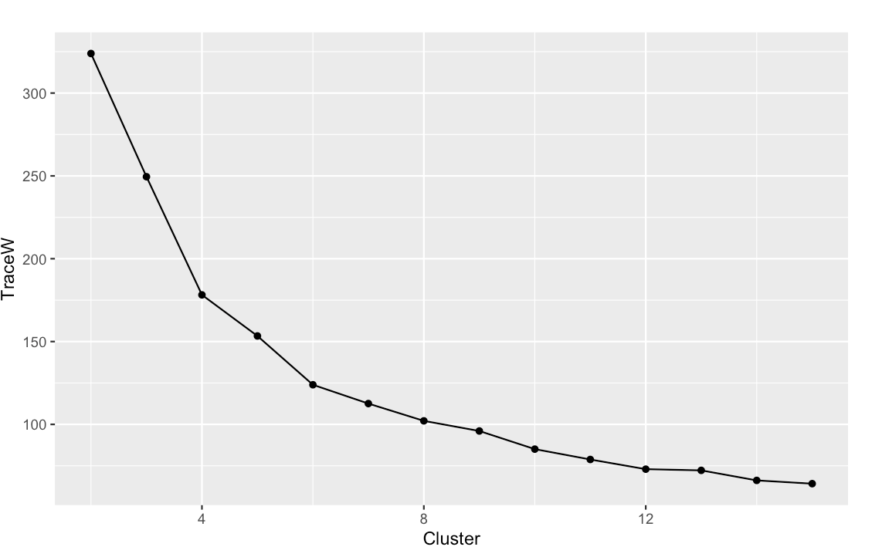
Clustering
Scree Plot
# of observations from sample in segments
Segments | 1 | 2 | 3 | 4 | 5 | 6 | 7
5 clusters | 3157 | 922 | 805 | 1904 | 3212
6 clusters | 1411 | 2294 | 767 | 897 | 2165 | 2466
7 clusters | 2120 | 2459 | 509 | 716 | 659 | 2252 | 1285
Based on the Scree plot, clusters between 5 - 7 were tested.
The bend of the Scree plot demonstrates at which point the variance starts to level off which is the perfect balance for the amount of variance and the complexity of the model.

Slide 12
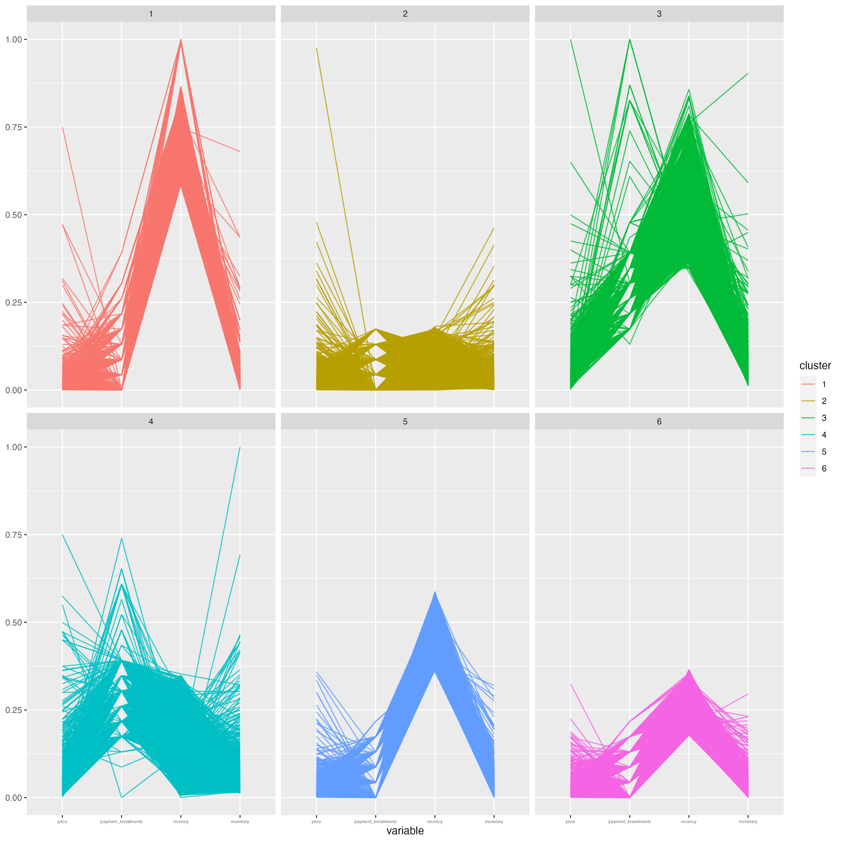
K-means clustering: 6 Segments
The model identified 6 different main patterns of behavior based on four variables.
 | 1 – Promising | 2 – Hibernating | 3 - Champions | 4 – Can’t lose them | 5 - Newcomers | 6 - About to hibernate
Product price | low | low | high | high | low | low
Payment installments | Medium | low | High | Medium-high | low | low
Recency | high | low | Medium to high | Low to medium-low | Medium-high | Medium-low
Monetary (spend) | medium | medium | Highest | Medium-high | low | low
*Random sample of 10,000 unique customers from the 94,000+ number of observations where all customers has an order status of “delivered” .

Slide 13
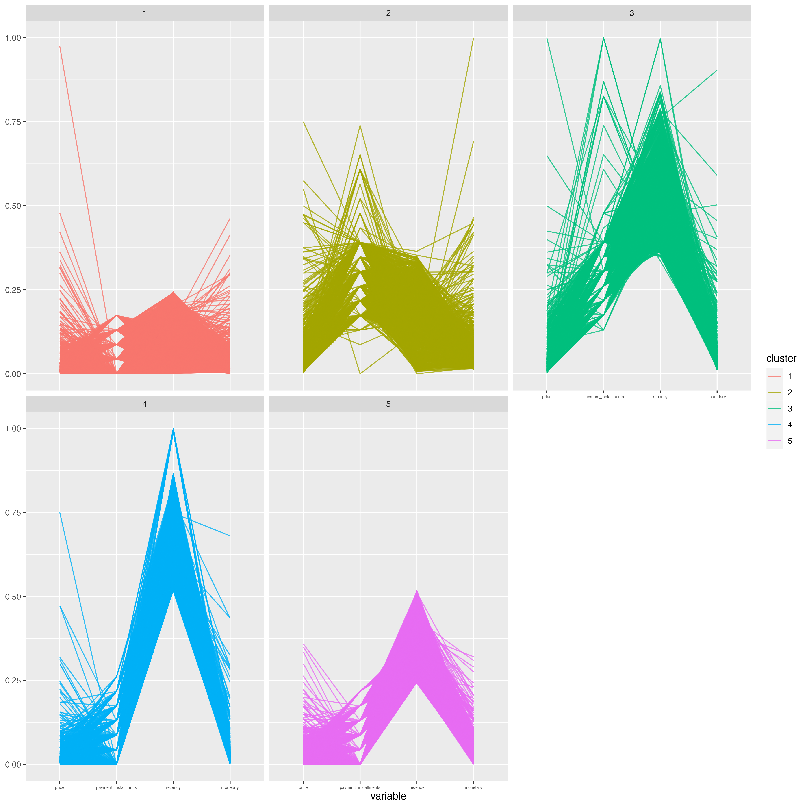
K-means clustering – 5 Segments
\

Slide 14
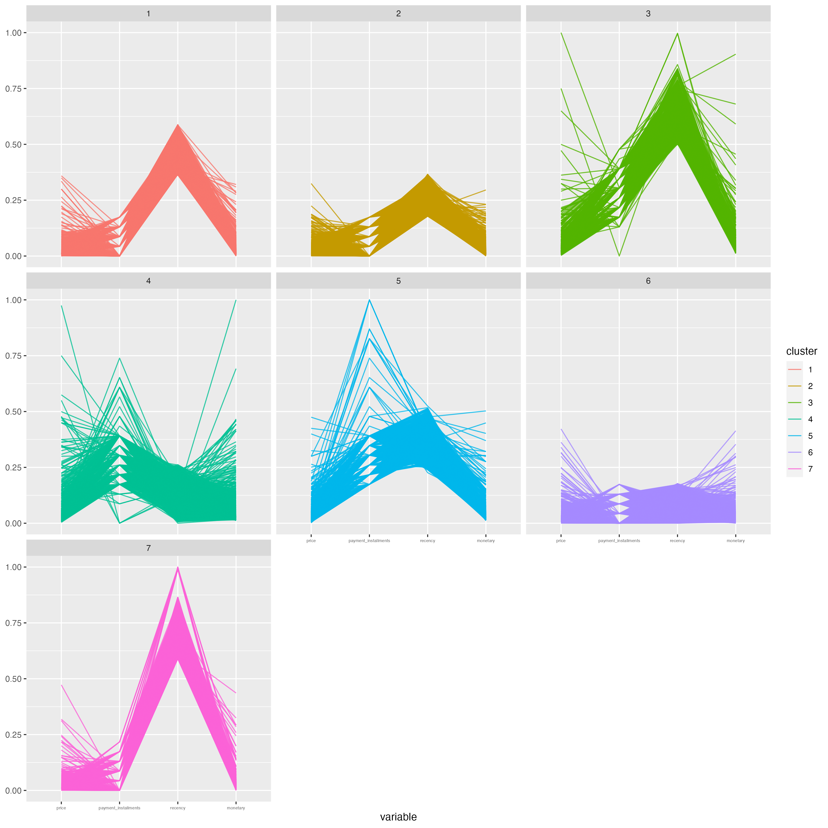
K-means clustering – 7 Segments

Slide 15
Customer Segmentation Profile
1. Promising
Has purchased recently.
Buys cheaper products but spends a medium amount.
2. Hibernating
Has not been purchased in a long time.
Purchases products at a lower price and spends a medium to low amount.
3. Champions
Has purchased recently.
Big spenders with high-priced products.
Financially aware and knows of Olist’s payment plan.
4. Can’t Lose
Has not been purchased in awhile.
Buys expensive products and spends a higher amount than others.
Financially aware and knows of Olist’s payment plan.
5. Newcomers
Has purchased recently.
Buys low-priced products.
Less aware of the payment plan.
6. About to Hibernate
Customers have not purchased so recently.
Does not spend much and buys products at a lower price.
Notes:
Look at the actual observations and see if they objectively purchased recently or not.

Slide 16
Action and Opportunities based on the Segments
Personalized Marketing Campaigns and Advertisements
Pricing and promotion strategies
Customer experience & channel strategies
Segments | Suggested Strategies
Promising | Targeted ads for website awareness, products and experience based benefits.
Hibernating | Use minimal resources, automated email marketing,
Champions | Loyalty campaign, reward system, keep them promoting the brand.
Can’t Lose Them | Customer retention campaign (offer discounts)
Newcomers | Start building a relationship, “on-boarding” support.
About to Hibernate | Customer retention campaign, recreate the value of a website

Slide 17
Applying Segmentation for Further Analysis
Using the segments to discover patterns within geography, customer product preferences, and review scores.

Slide 18
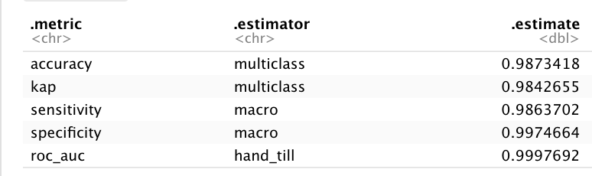
Predict the Cluster with the larger database
Random forest

Slide 19
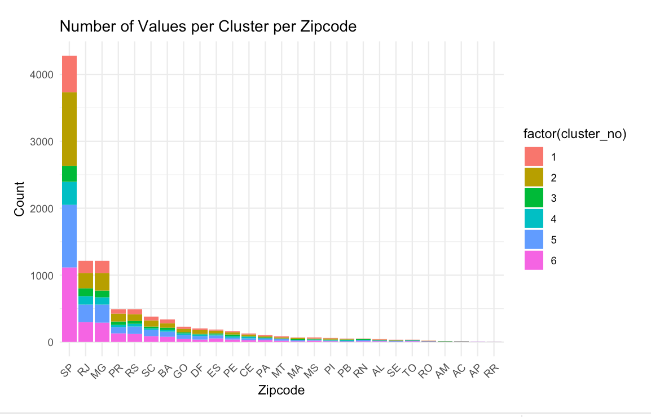
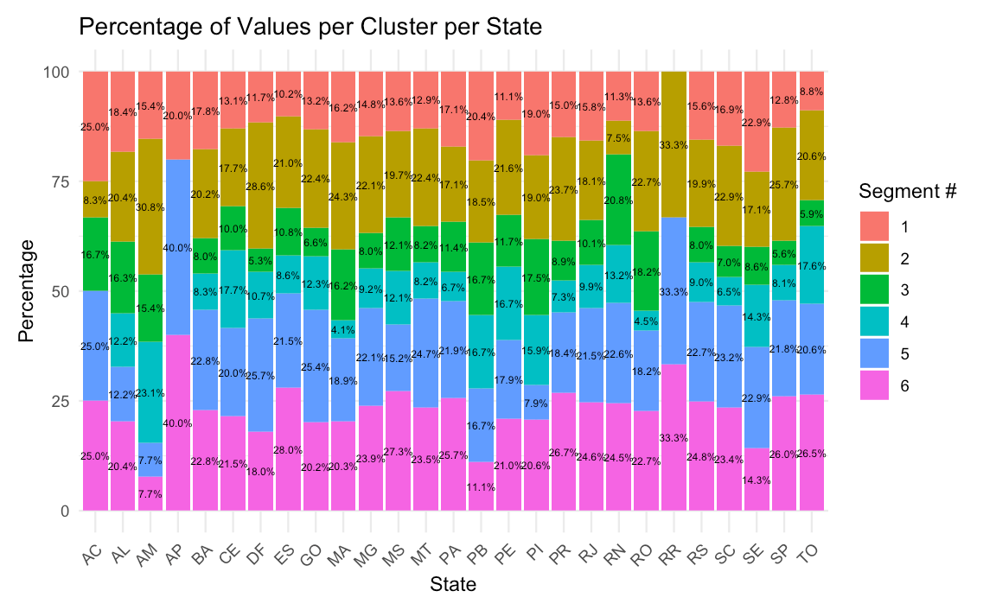
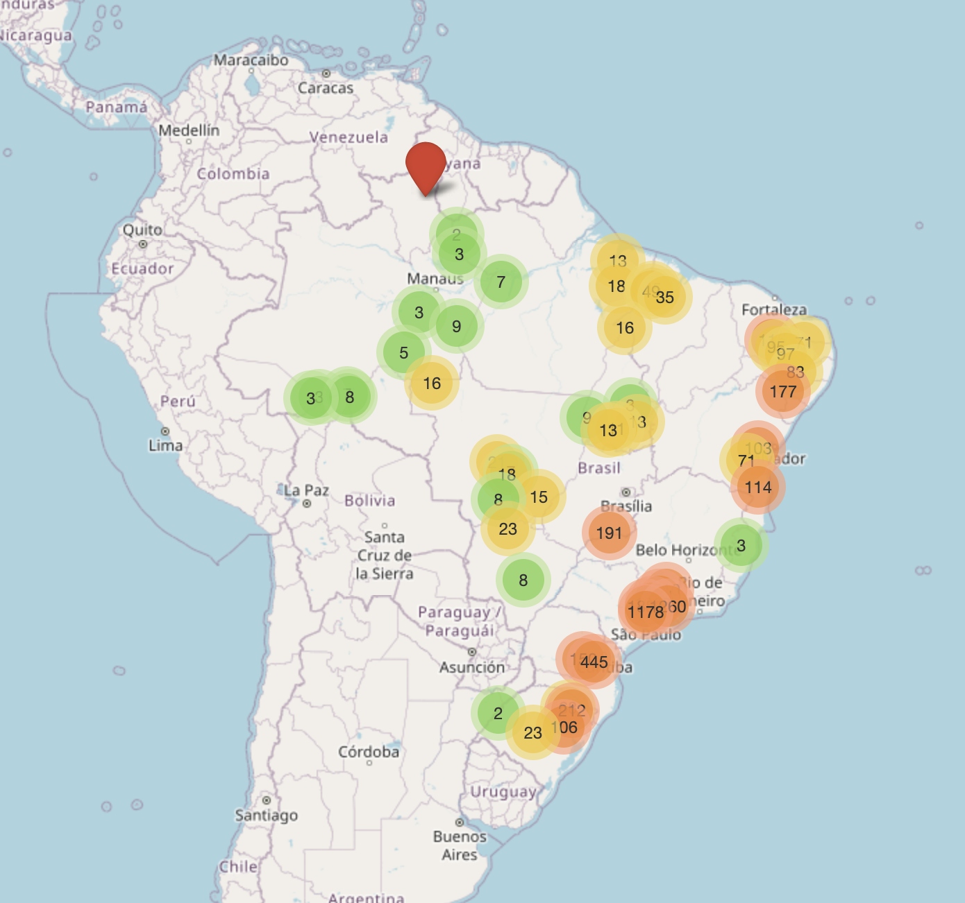
Customer Segmentation & Geography
There is not a drastic difference in clusters between states.
In descending order, Sao Paulo, Rio de Janeiro, Minas Gerais, Curitiba, Rio Grande do Sul are the top 5 most populated states that use Olist
% of Segments Per State
Promising | Hibernating | Champions | Can’t Lose Them | Newcomers | About to Hibernate
Notes:
A suggestion to target marketing in concentrated regions

Slide 20
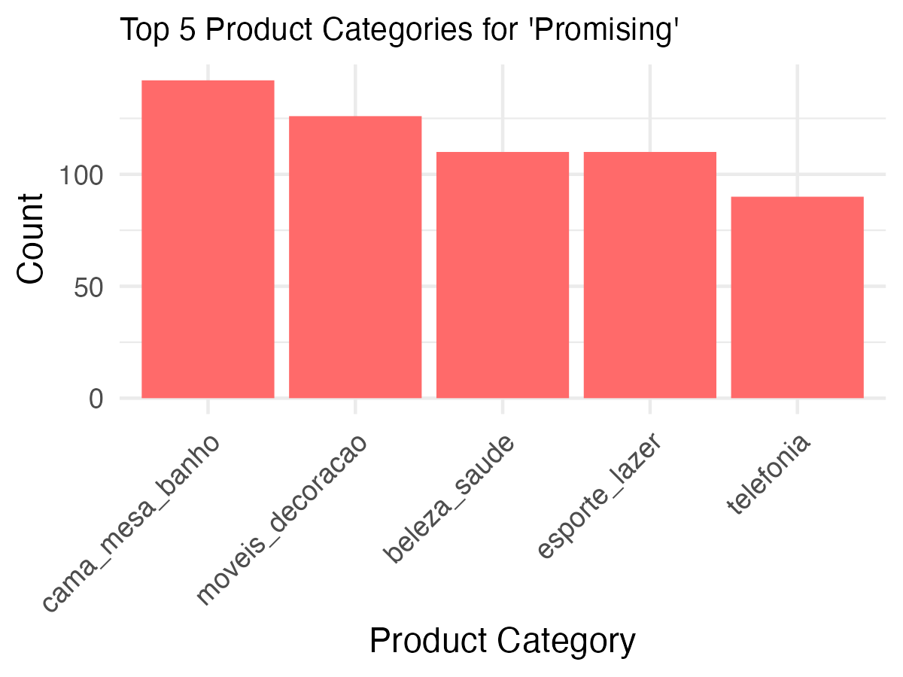
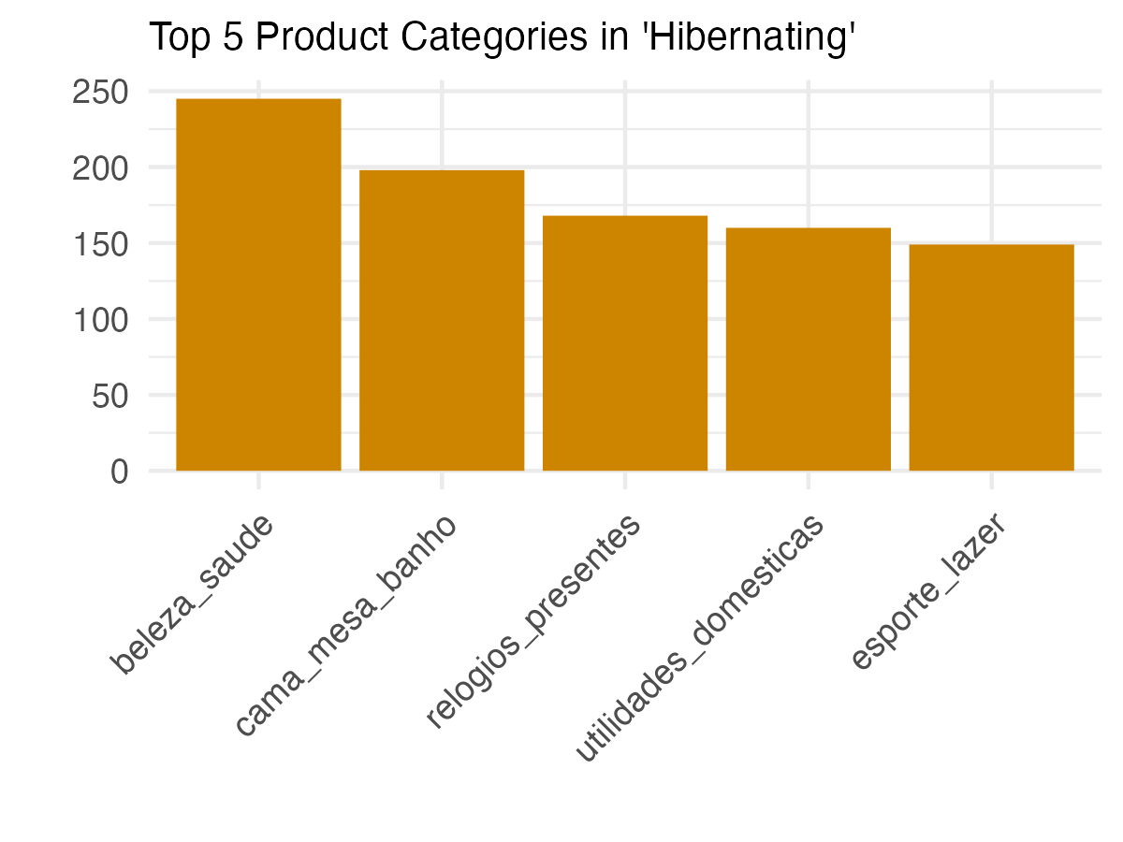
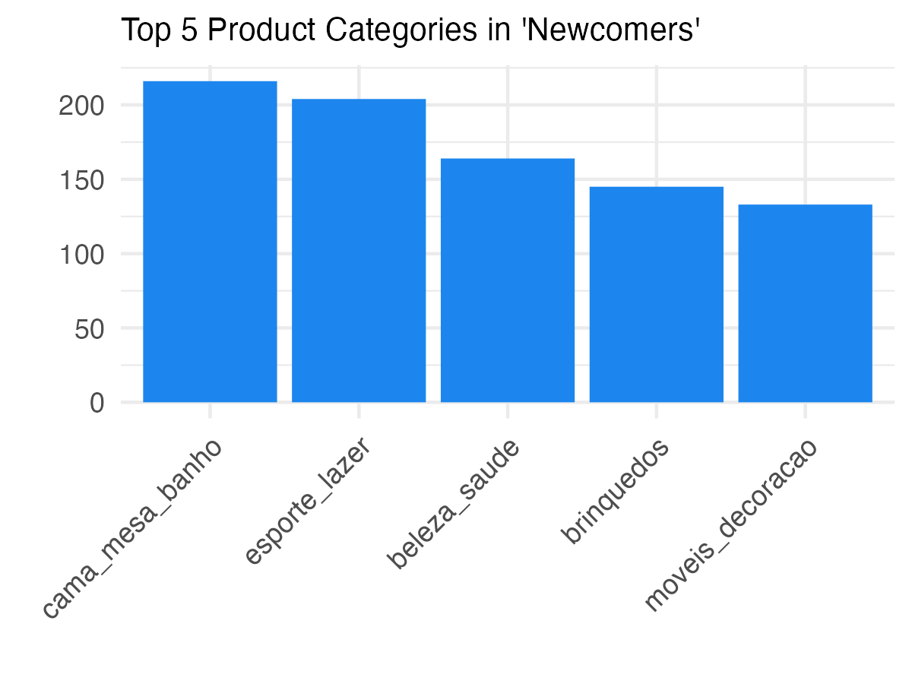
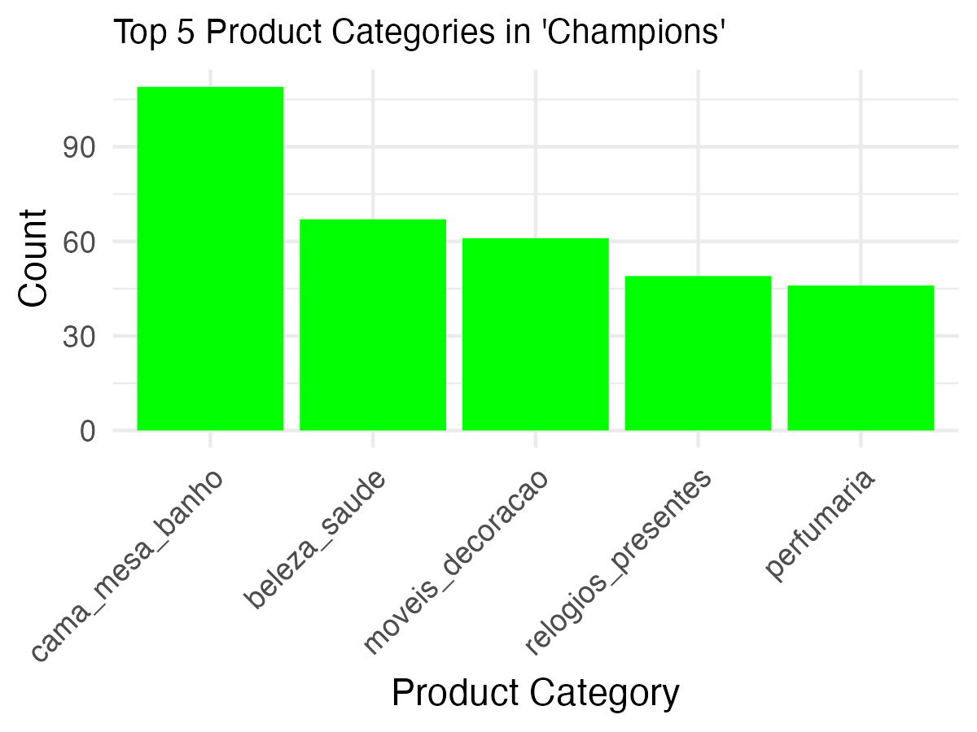
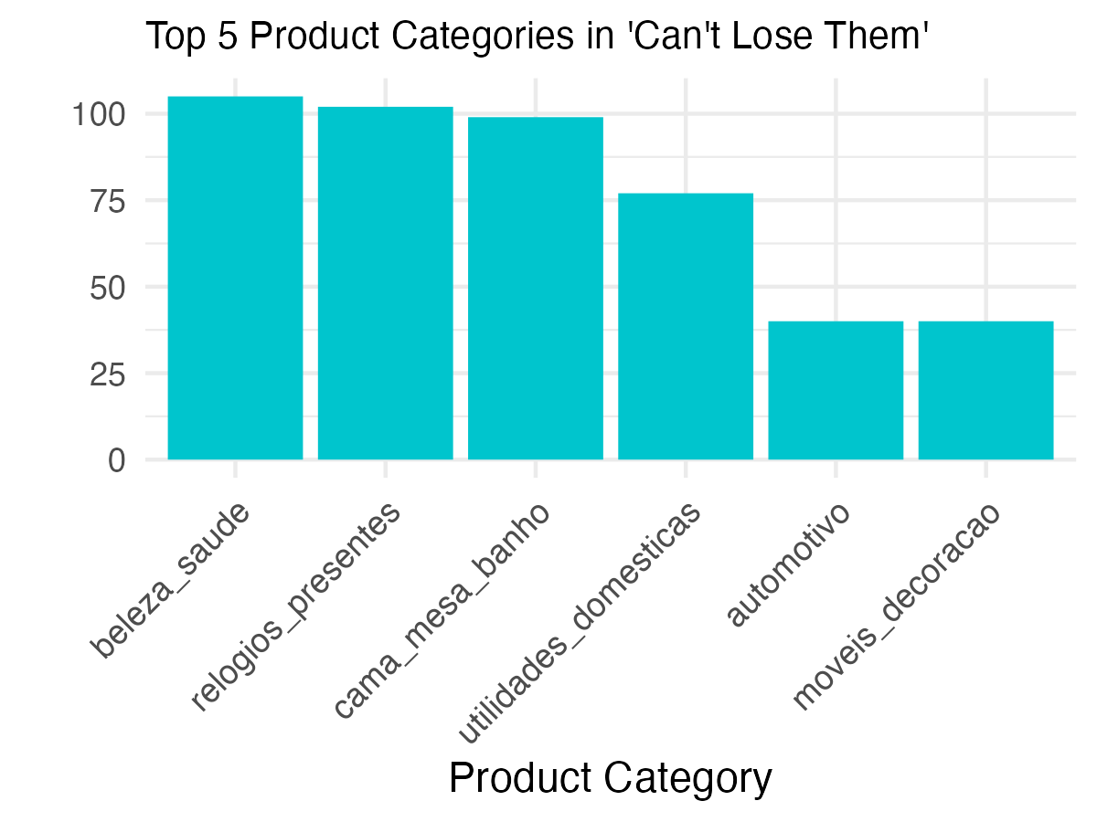
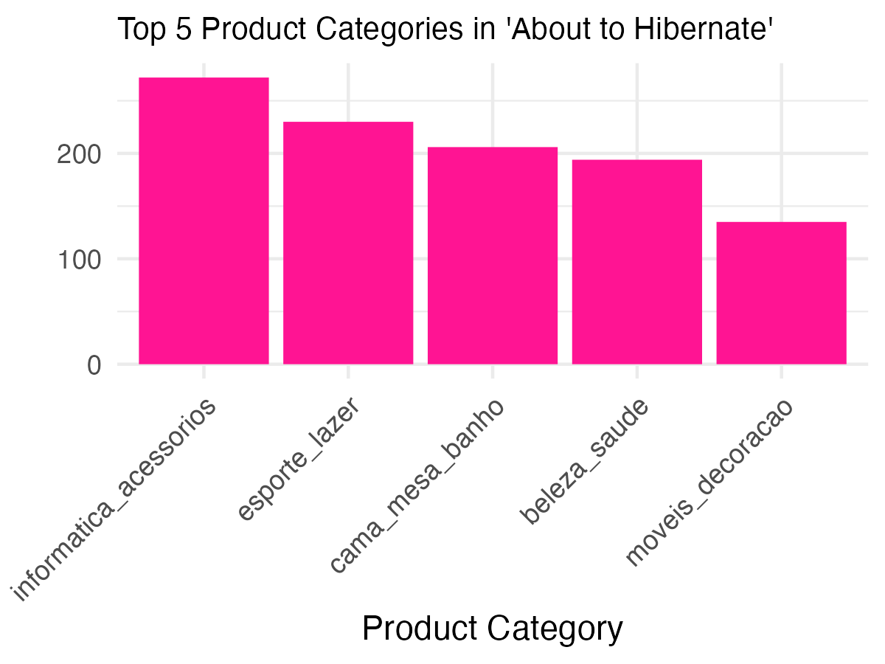
Customer Segmentation & Product: Top 5 Categories
‘The top 5 categories per cluster vary slightly, demonstrating different product preferences
‘Bed, bath, table’ and ‘health & beauty’ are popular amongst all clusters.
Housewares
Toys
Health & beauty
Furniture Decor
Sports leisure
Telephony
Bed, bath, table
Bed, bath, table
Furniture Decor
Sports leisure
Health & beauty
Watches, gifts
Sports leisure
Bed, bath, table
Health & beauty
Auto
Perfumery
Housewares
Sports leisure
Furniture Decor
Furniture Decor
Health & beauty
Health & beauty
Bed, bath, table
Watches, gifts
Watches, gifts
Computers, accessories
Furniture Decor
Bed, bath, table
Bed, bath, table
Health & beauty

Slide 21
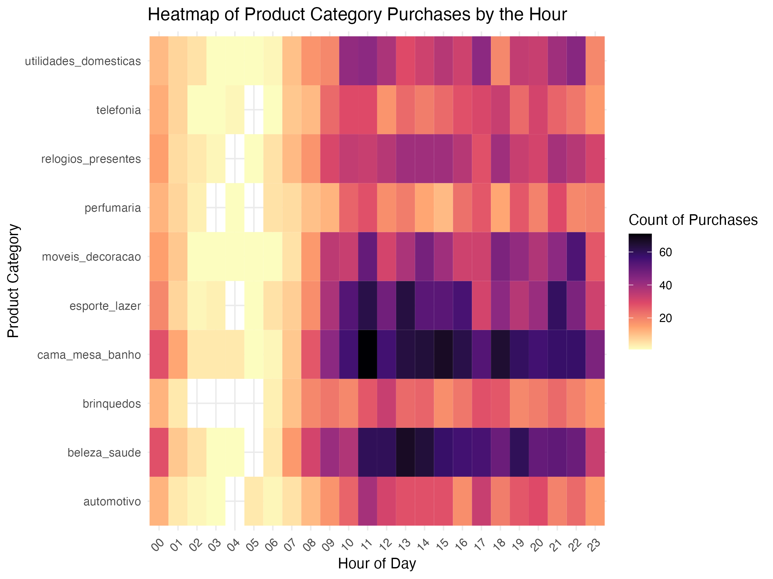
Customer Segmentation & Product: Top Categories & Purchasing Time
Heatmap of Product Category Purchases by the Hour
Housewares
Choosing the optimal time & product for business actions
Telephony
Watches & gifts
“Bed, bath, and table” & “Health & Beauty” are among the top purchased categories.
Products are heavily purchased between 12PM – 4PM.
Products are least purchased between 1AM and 6AM.
Perfumery
Furniture Decor
Sports leisure
Bed, bath, table
Toys
Health & Beauty
Auto

Slide 22
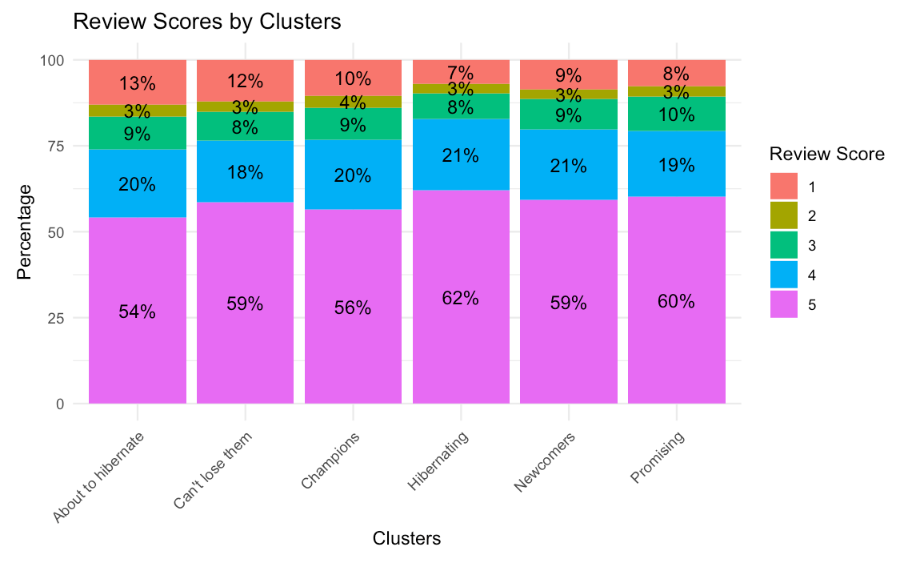
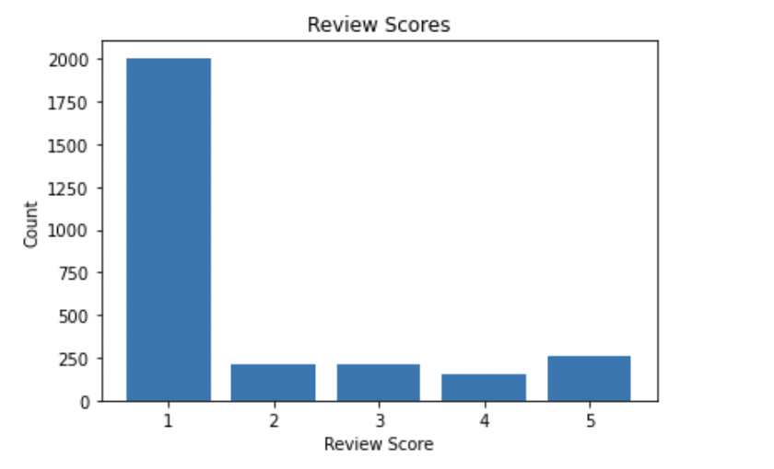
Customer Segmentation & Order Reviews
There is not a drastic difference in clusters between how they rate products.
Large percentage of people give 5-star reviews, those that don’t mainly are the ones who don’t receive an order.
Review Scores by Clusters
Review Scores of Customers who Don’t Receive their product.

Slide 23
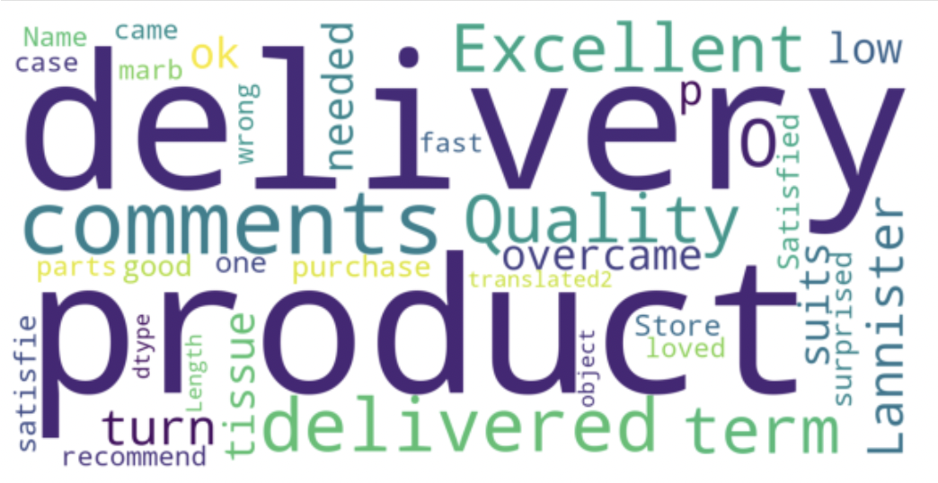
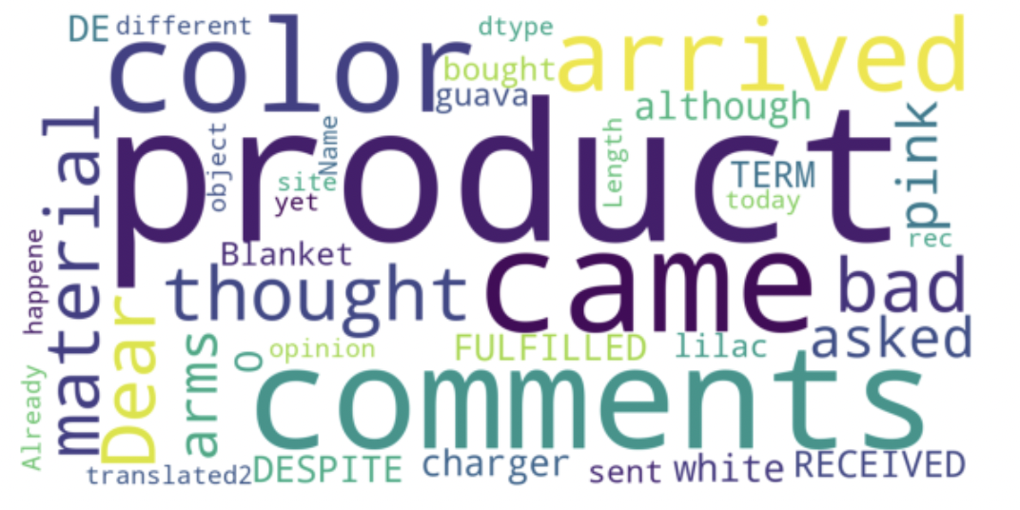
Customer Segmentation & Order Reviews
Understanding customer sentiment and common themes within well-performing and underperforming products.
Positively associated words as found for higher scores and negatively associated words are found for lower scores.
Product Review scores between 3 - 5
Product Review scores between 1-2

Slide 24
Conclusion
Further business recommendations, and the next steps for data analytics.

Slide 25
Further Recommendations & Next Steps
1
2
3
4
Find the optimal time, place, product, and channel to send out personalized messages and advertisements
A/B testing and experimentation to continuously improve our targeting.
Attract a loyal customer base by creating a loyalty program
Keep track of the “frequency” that a customer visits the website.
There is currently a very low amount of customers that purchase more than one. product and a low number of “frequency” > 1 .
Collect demographic data for segmentation
Creating targeted ads based on demographic and interests.
Continuous improvement of data analysis & models
Apply segmentation to the larger database via machine learning.
Natural Language Processing (NLP) to deep-dive into the reviews and scores.

Slide 26
Thank You
Do you have any questions?

